Slide 1
Image Classification
With CNN model
DS4기 5조
박 선영, 박 봉현, 조 남영

Slide 2
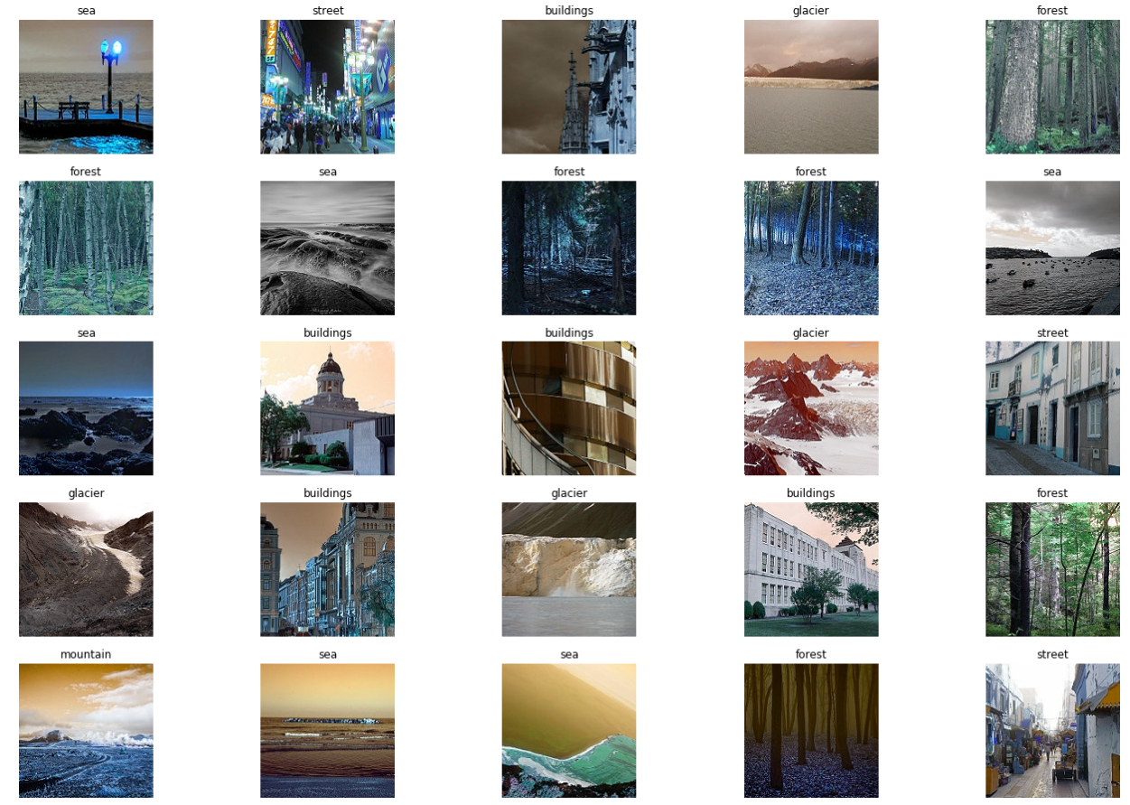
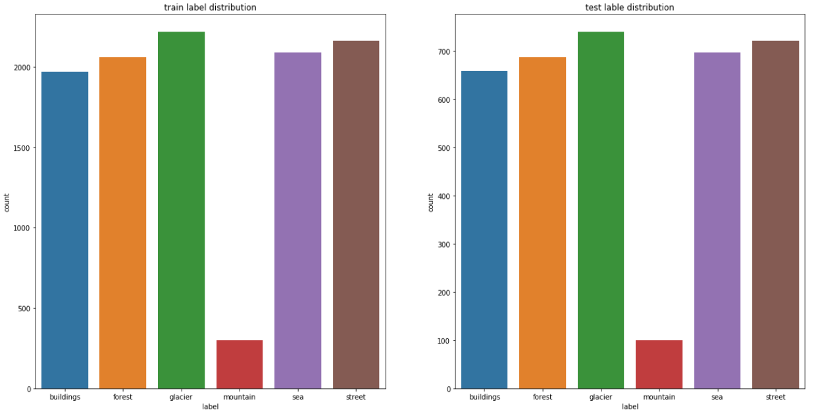
EDA
□ Image data review
□ label - buildings, forest, glacier, mountain, sea, street
※ Imbalanced image data – “mountain image”

Slide 3
Preprocessing
□ title
- contents

Slide 4
Model fit & validation
□ title
- contents

Slide 5
Model accuracy
□ title
- contents

Slide 6
Conclusion
□ train data quantity 중요성
. Mountain image의 경우, 다른 image 대비 train data 부족으로 인해 모델 정확도가 떨어짐
. Image Argumentation 기법을 통한 Train data 확보 기법 적용 필요
. 아무리 최적화 된 Model 이라 하더라도, 무엇보다 train data quantity 선행 확보 필요함
□ title 2
This PowerPoint Template has clean and neutral design that can be adapted to any content and meets various market segments. With this many slides you are able to make a complete PowerPoint Presentation that best suit your needs.

